Slide 1
Pipelines and Work flow

Slide 2
Outline of the work to be done
Script/structure to run it

Slide 3
Galaxy work flow

Slide 4
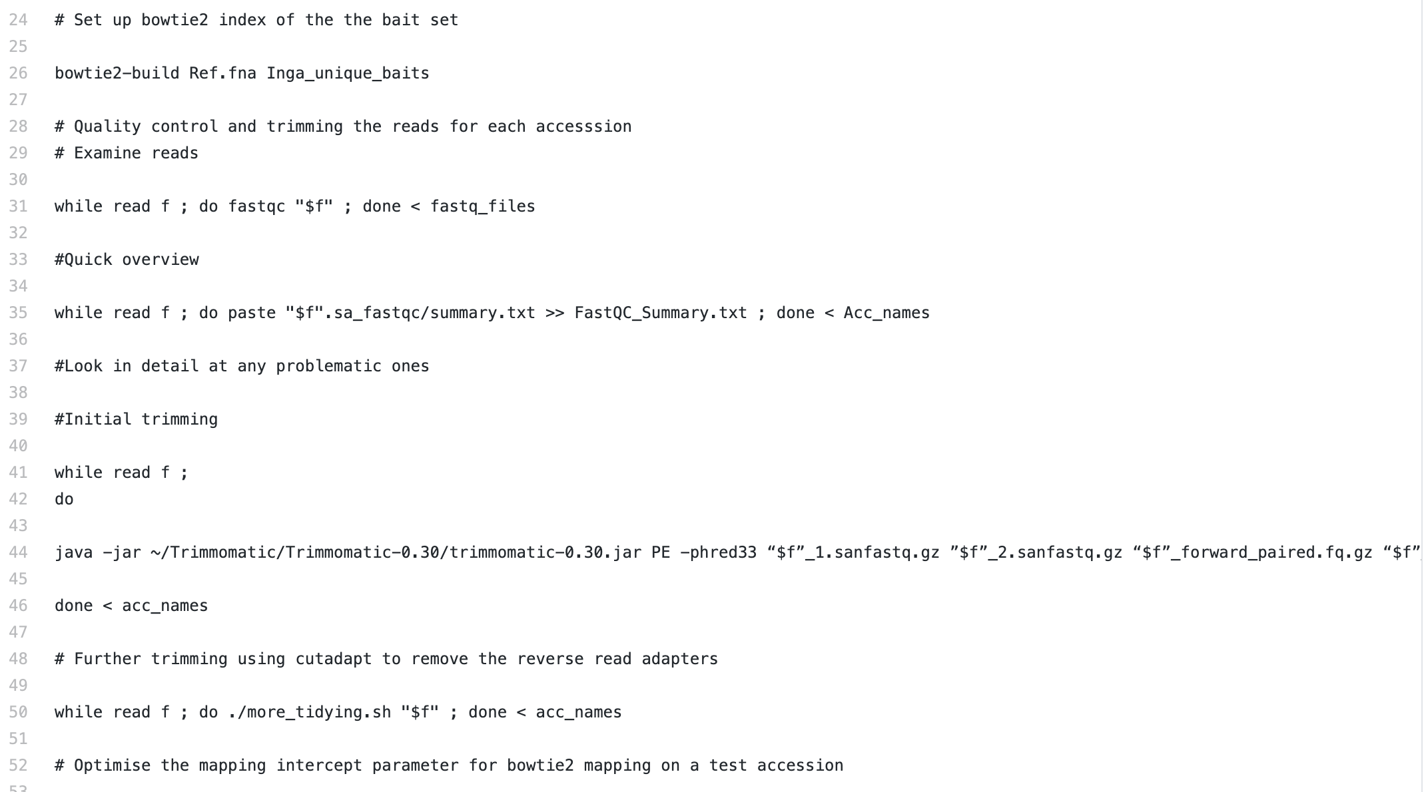
Using a Pseudo-shell script

Slide 5
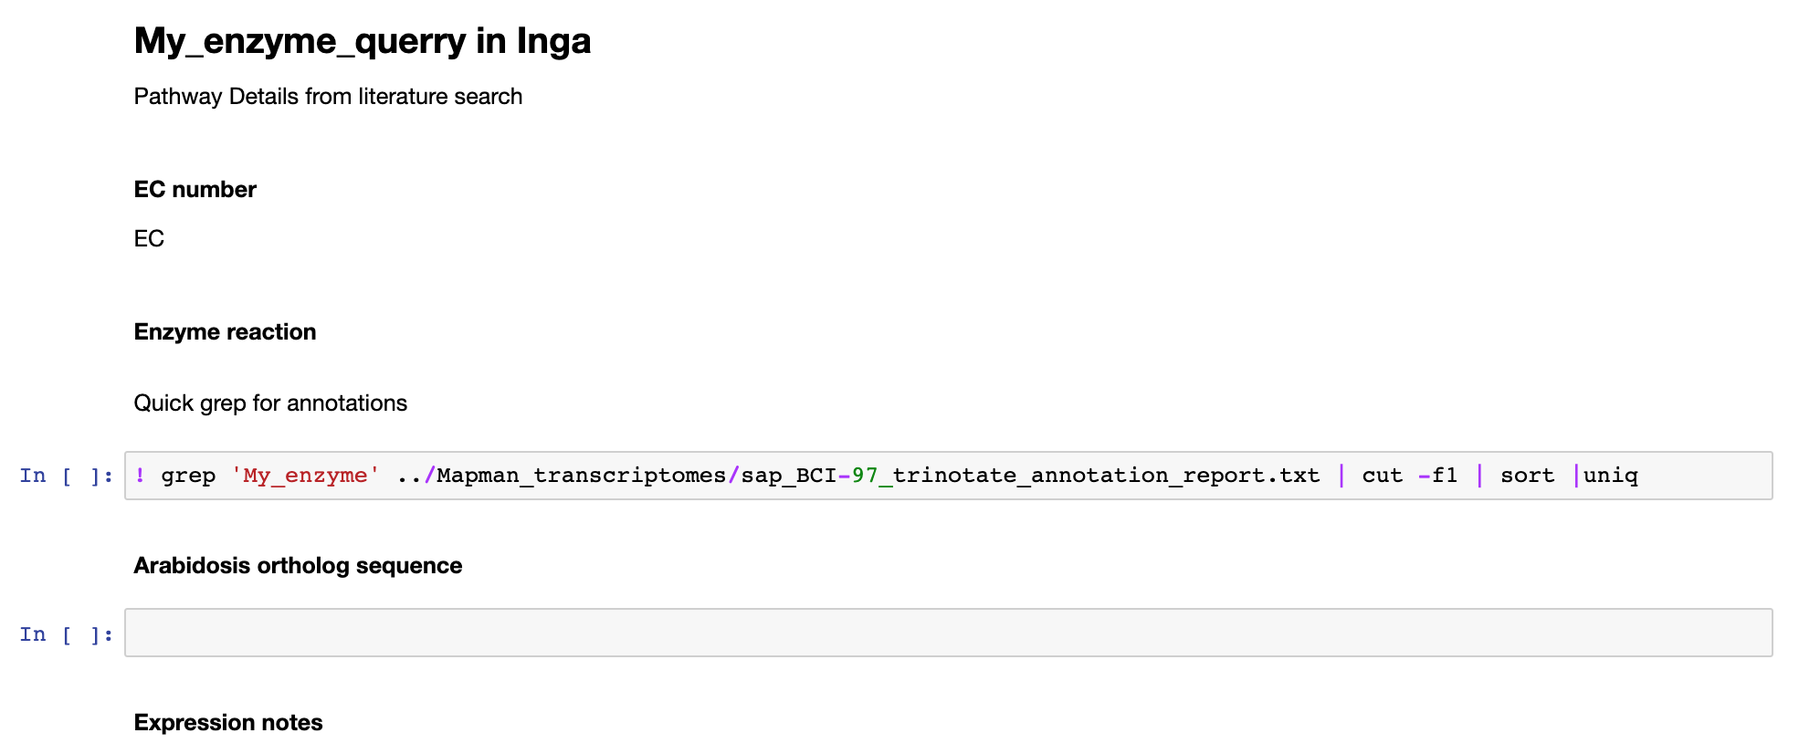
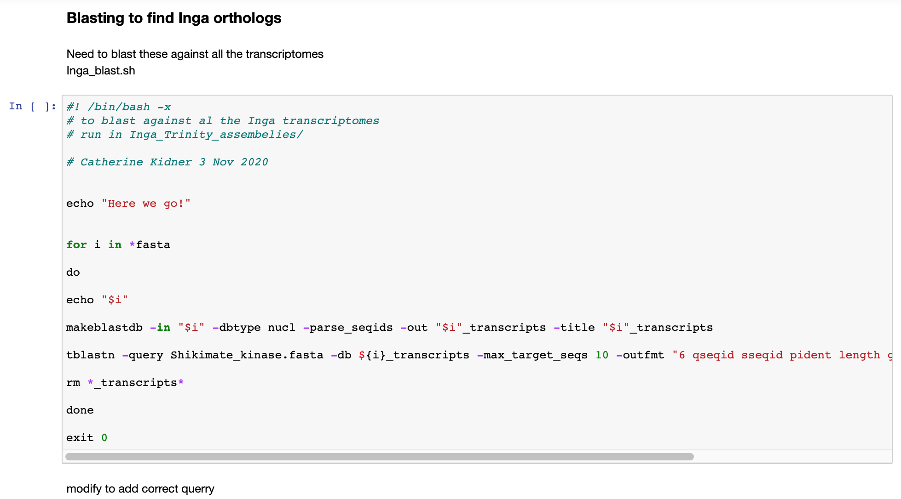
Using a jupyter notebook

Slide 6
Using a proper shell script
#!/bin/bash
set -e
set -u
set -o pipefail
sample1="AB_genotyping"
sample2="Cynthia_genotyping"
vcf1=/mnt/shared/projects/rbge/Begonia_map/${sample1}.vcf.gz
vcf2=/mnt/shared/projects/rbge/Begonia_map/${sample2}.vcf.gz
#check files exist
test –e $vcf1 ; echo “missing ” $vcf1
test –e $vcf2 ; echo “missing ” $vcf2
#index vcf files
tabix $vcf1
tabix $vcf2
#pick overlaps
bcftools isec -p Shared $vcf1 $vcf2
#call
python Pull_genotypes_OneMap.py shared/0003.vcf
exit

Slide 7
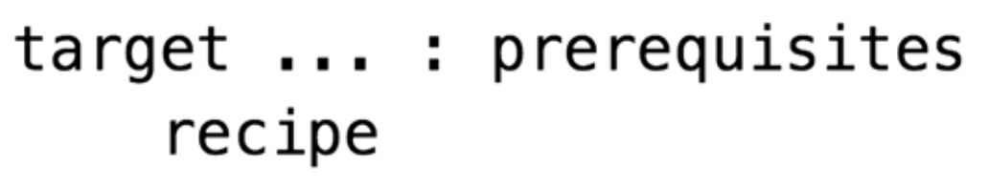
Makefiles
FASTA_FILE_LINK=http://bit.ly/my_gene
.PHONY: all clean
all: my_gene_comp.txt
my_gene.fa:
curl –L $(FASTA_FILE_LINK) > my_gene.fa
my_gene.txt: my_gene.fa
seqtk comp my_gene.fa > my_gene _comp.txt
clean:
rm –f my_gene.fa my_gene _comp.txt
Define a variable
Targets
Target files produced
make all will run this command
Rule which downloads the sequence file
Rule which summarises the sequence file
make clean will run this command
Vince Buffalo Bioinformatic Data Skills

Slide 8

https://snakemake.readthedocs.io/en/stable/tutorial/basics.html

Slide 9
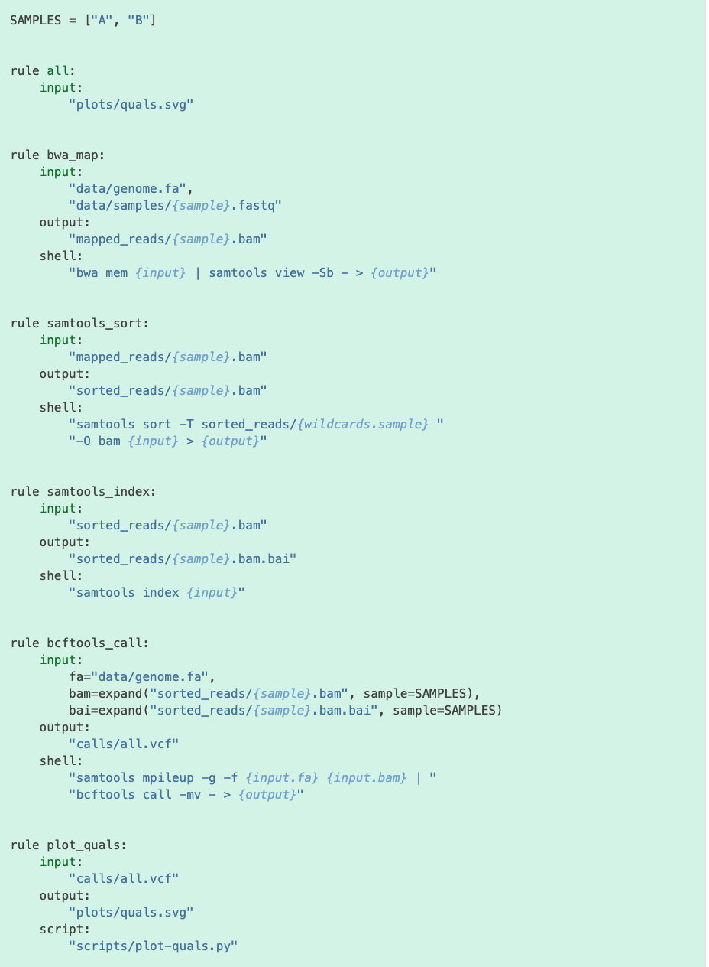
Plot quality scores

Slide 10
import matplotlib
matplotlib.use("Agg")
import matplotlib.pyplot as plt
from pysam import VariantFile
quals = [record.qual for record in VariantFile(snakemake.input[0])] plt.hist(quals)
plt.savefig(snakemake.output[0])

Slide 11

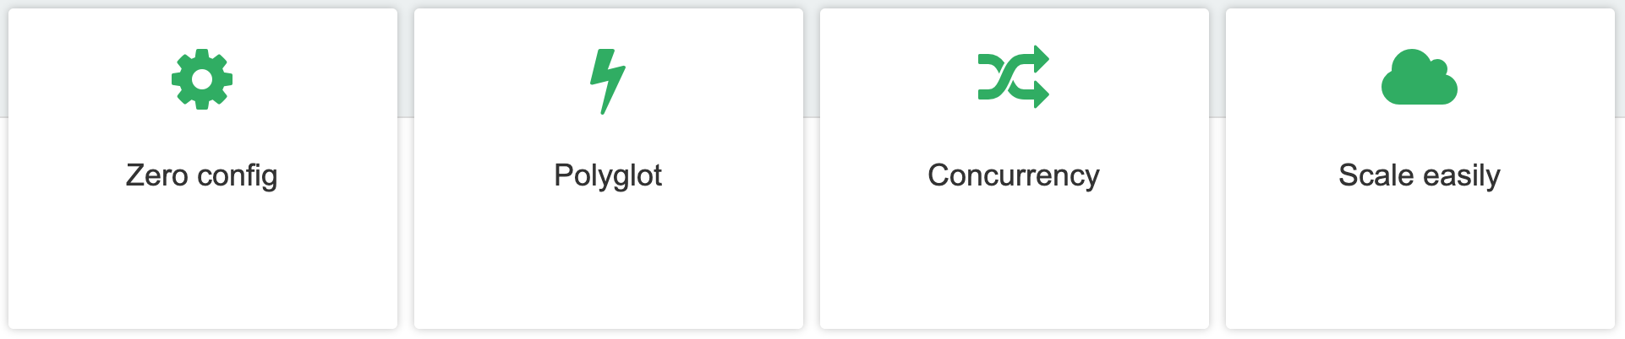
Disadvantage compared to snakemake: based on groovy, not python
Advantage over snakemake: better support for Docker, Singularity, and HPC environments

Slide 12
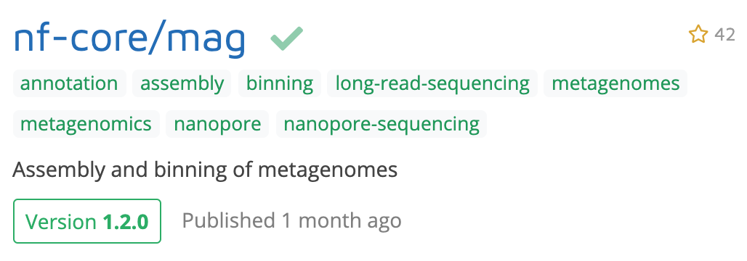
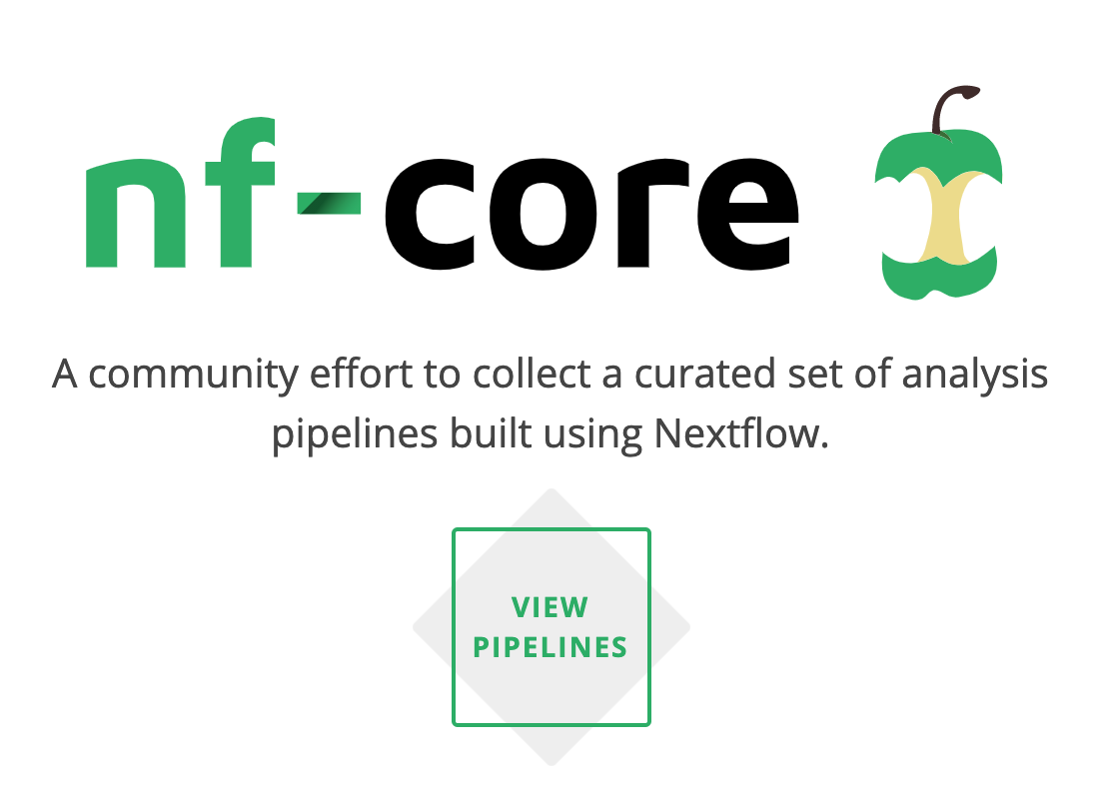
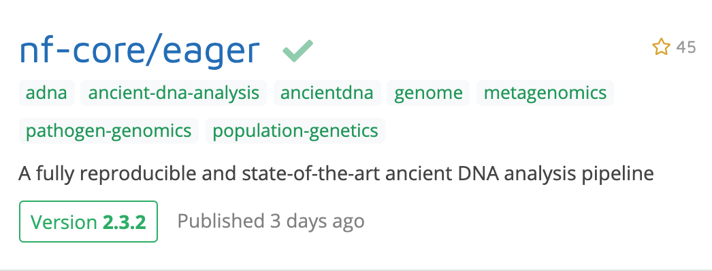
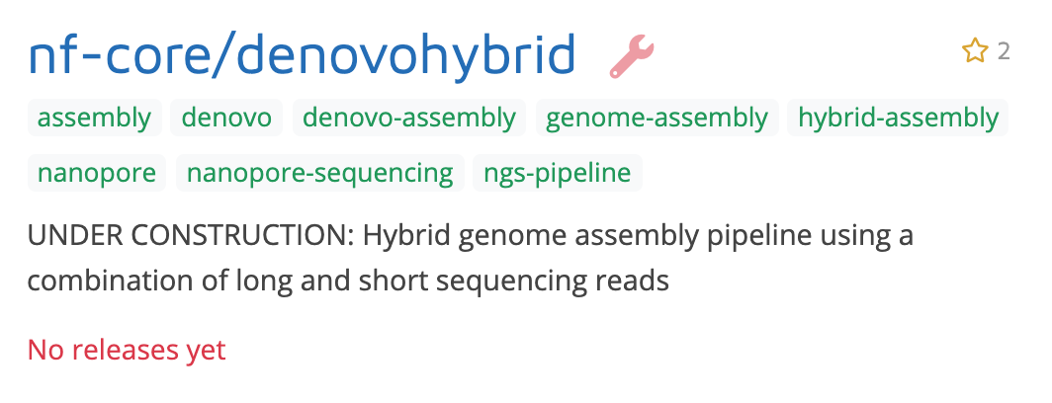
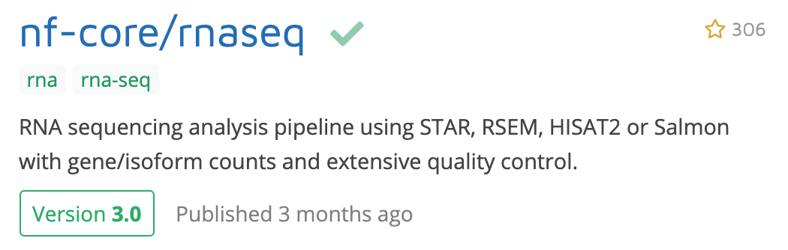

Slide 13
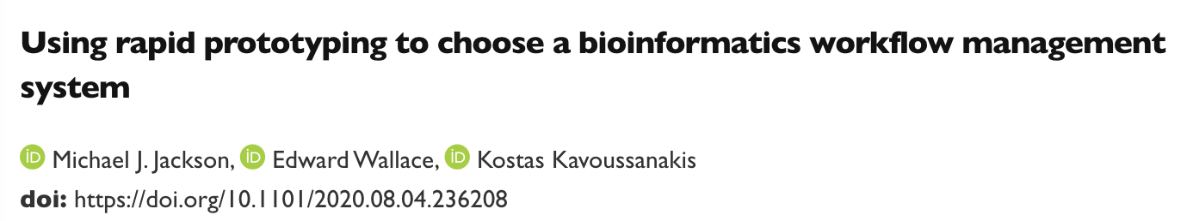
We decided to adopt Nextflow for the following reasons.
It was our subjective impression that Nextflow felt far richer than Snakemake both in terms of features and expressivity,
and it was felt that these outweighed its lack of a dry-run feature.
The execution of each step within isolated subdirectories is useful for debugging.
While writing Nextflow workflows does require knowledge of Groovy, the authors, familiar with
Python and R, did not find learning Groovy challenging.
The fact that Nextflow was based on Java incurs no additional installation overhead for either users or developers compared
to Snakemake – each can be installed using the conda package manager using a single command.
Based on our impressions of their documentation, Nextflow’s built-in support for, and documentation around, containers,
HPC systems and cloud, seemed more thorough than that of Snakemake (though we appreciate that this may change as both
tools evolve).

Slide 14
How do you run your workflows?

